Slide 1

Solution Sales Training
NDI & Cameras
Powerful · Reliable · Simple

Slide 2
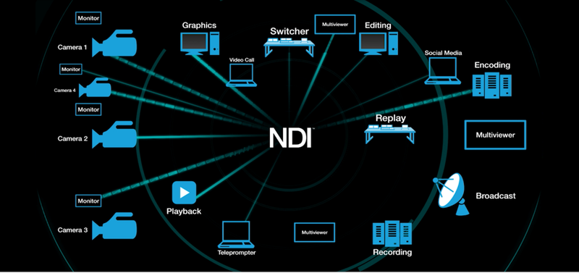
NDI® & NDI® 6 – Why It’s Used in Modern AV Workflows
What is NDI® 6?
Latest generation of NDI (Network Device Interface) developed by Vizrt
Transports high-quality video, audio, and metadata over standard IP networks
Why NDI is Utilized:
Leverages Standard IT Infrastructure
Uses existing Ethernet networks instead of dedicated video cabling
Reduces installation cost and deployment complexity
Low Latency, High Quality Video
Near real-time performance suitable for live production and conferencing
Supports HD and 4K video with synchronized audio and metadata
Simple Deployment & Scalability
Automatic device discovery and routing
Easily add cameras, PCs, or displays without redesigning systems
Flexible Software-Driven Workflows
Native integration with Teams, OBS, vMix, Zoom, and broadcast tools
Many workflows handled via software instead of dedicated hardware
Bi-Directional & Distributed Operation
Send and receive video/audio on the same network
Enables remote production, hybrid environments, and centralized control
Future-Ready AV Architecture
Any source can be viewed, recorded, streamed, or displayed anywhere on the network
Powerful · Reliable · Simple

Slide 3

Opportunity
The Market Gap
Conferencing platforms (Teams, Zoom, Meet) rely on USB video inputs
Modern AV systems are moving to NDI based video workflows
These two worlds don’t naturally connect
Result: Customers invest in cameras and AV infrastructure but can’t fully use them in meetings without complex workflows
Powerful · Reliable · Simple

Slide 4

Opportunity
What Customers Are Asking For
Multiple camera angles in meetings
Ability to mix presenter + content + audience
Simple, non-technical operation
Compatibility with existing platforms (no new software)
Flexibility to use both local and network sources
The Opportunity
Rapid growth in:
Hybrid work environments
Hybrid / remote education
Multi-camera meeting expectations
Increased adoption of:
NDI-enabled cameras
Powerful · Reliable · Simple

Slide 5
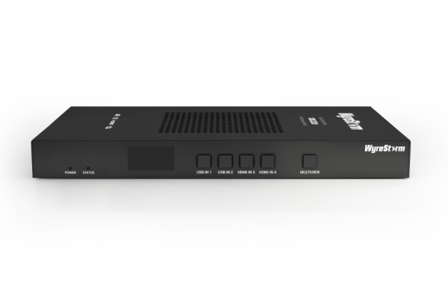
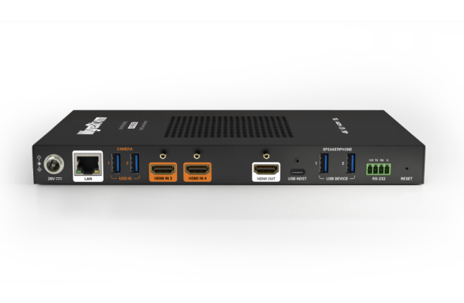
What is the CAM-0402-NDI-BRG?
A multi-camera video bridge that combines HDMI, USB, and NDI sources into a single output for conferencing, streaming, and recording
What It Does
Ingests up to 8 video sources total:
2x HDMI (laptops, cameras)
2x USB (UVC cameras)
4x NDI (network cameras)
Combines sources into:
Single view or multiview (quad-view)
Outputs simultaneously to:
USB (Teams/Zoom as a webcam)
HDMI (local display)
Powerful · Reliable · Simple

Slide 6
What is the CAM-0402-NDI-BRG?
A multi-camera video bridge that combines HDMI, USB, and NDI sources into a single output for conferencing, streaming, and recording
Why It Matters
Bridges professional AV systems (NDI) with everyday conferencing (USB)
Eliminates need for:
External switchers
PC-based production software
Enables multi-camera meetings with plug-and-play simplicity
Powerful · Reliable · Simple

Slide 7
What is the CAM-0402-NDI-BRG?
A multi-camera video bridge that combines HDMI, USB, and NDI sources into a single output for conferencing, streaming, and recording
How Users Experience It
Connect laptop via USB
Select it as a webcam in Teams/Zoom
Switch cameras using:
Front panel buttons
Web UI
API / Control system
Microsoft Teams app integration
Powerful · Reliable · Simple

Slide 8
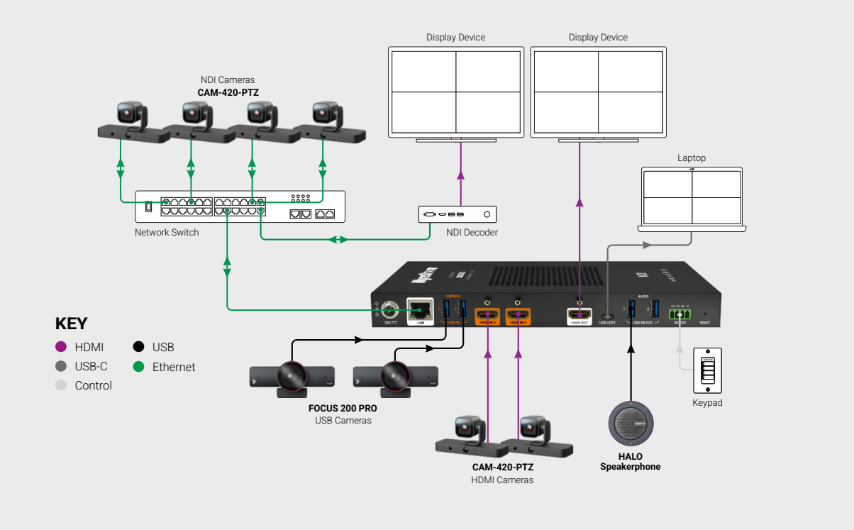
System Diagram
Powerful · Reliable · Simple

Slide 9
Vertical 1 (Corporate/Boardroom)
The Problem
Executive meetings are still single-camera and static
Remote participants struggle to see:
Who is speaking
Room dynamics
Presented content clearly
Traditional solutions require:
Complex AV systems
Dedicated operators
Existing investments (PTZ cameras, AV-over-IP) are underutilized in Teams/Zoom
Result: High-value meetings feel flat, disengaging, and lack professionalism
Powerful · Reliable · Simple

Slide 10
Vertical 1 (Corporate/Boardroom)
The Solution: CAM-0402-NDI-BRG
Combines multiple boardroom sources into one unified output:
PTZ cameras (NDI or HDMI)
Content laptop (HDMI)
Additional USB cameras (wide angle, table view)
Outputs as a single USB webcam to:
Microsoft Teams
Zoom
Webex
Powerful · Reliable · Simple

Slide 11


Vertical 2 (Education/Lecture Capture)
The Problem:
Hybrid classrooms require multiple views at once:
Instructor
Whiteboard / content
Student interaction
Classrooms rely on:
Single camera setups → low engagement
Manual switching or complex systems → difficult to use
IT teams need:
Simple, scalable solutions
Minimal training for faculty
Result: Remote students miss context, and in-room experiences don’t translate effectively online
Powerful · Reliable · Simple

Slide 12

Vertical 2 (Education/Lecture Capture)
The Solution: CAM-0402-NDI-BRG
Combines multiple classroom sources into one output:
Instructor camera (NDI or USB)
Document camera (USB)
Additional NDI cameras (student view, wide shot)
Outputs as a single USB webcam to:
Microsoft Teams
Zoom
Lecture capture platforms
Powerful · Reliable · Simple

Slide 13
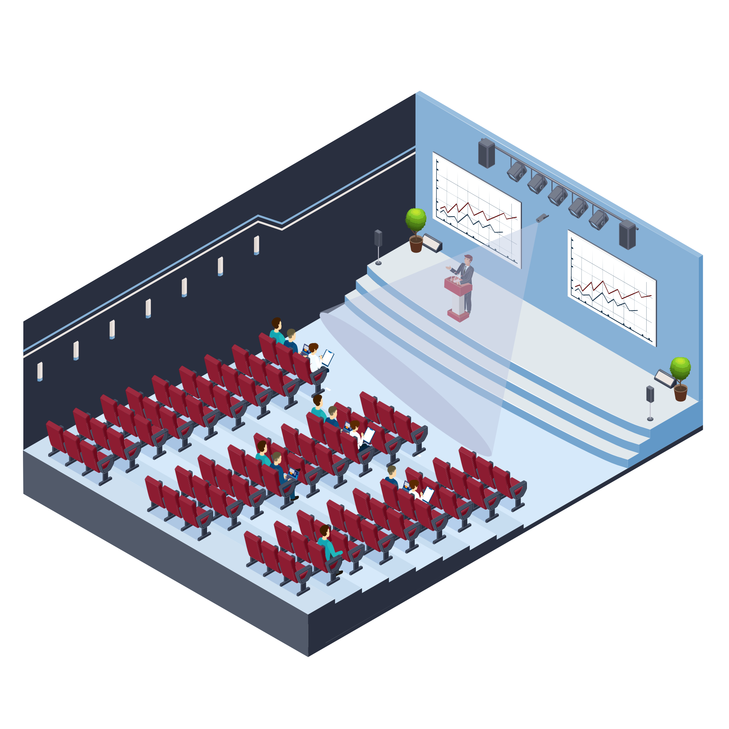
Vertical 3 (Enterprise Events)
The Problem
Live events require:
Multiple camera angles
Content feeds
Flexible switching
Traditional setups are:
Expensive (switchers, operators, encoders)
Complex to deploy
Not scalable for smaller events
Result: Many organizations avoid multi-camera production or rely on low-quality single-camera streams
Powerful · Reliable · Simple

Slide 14
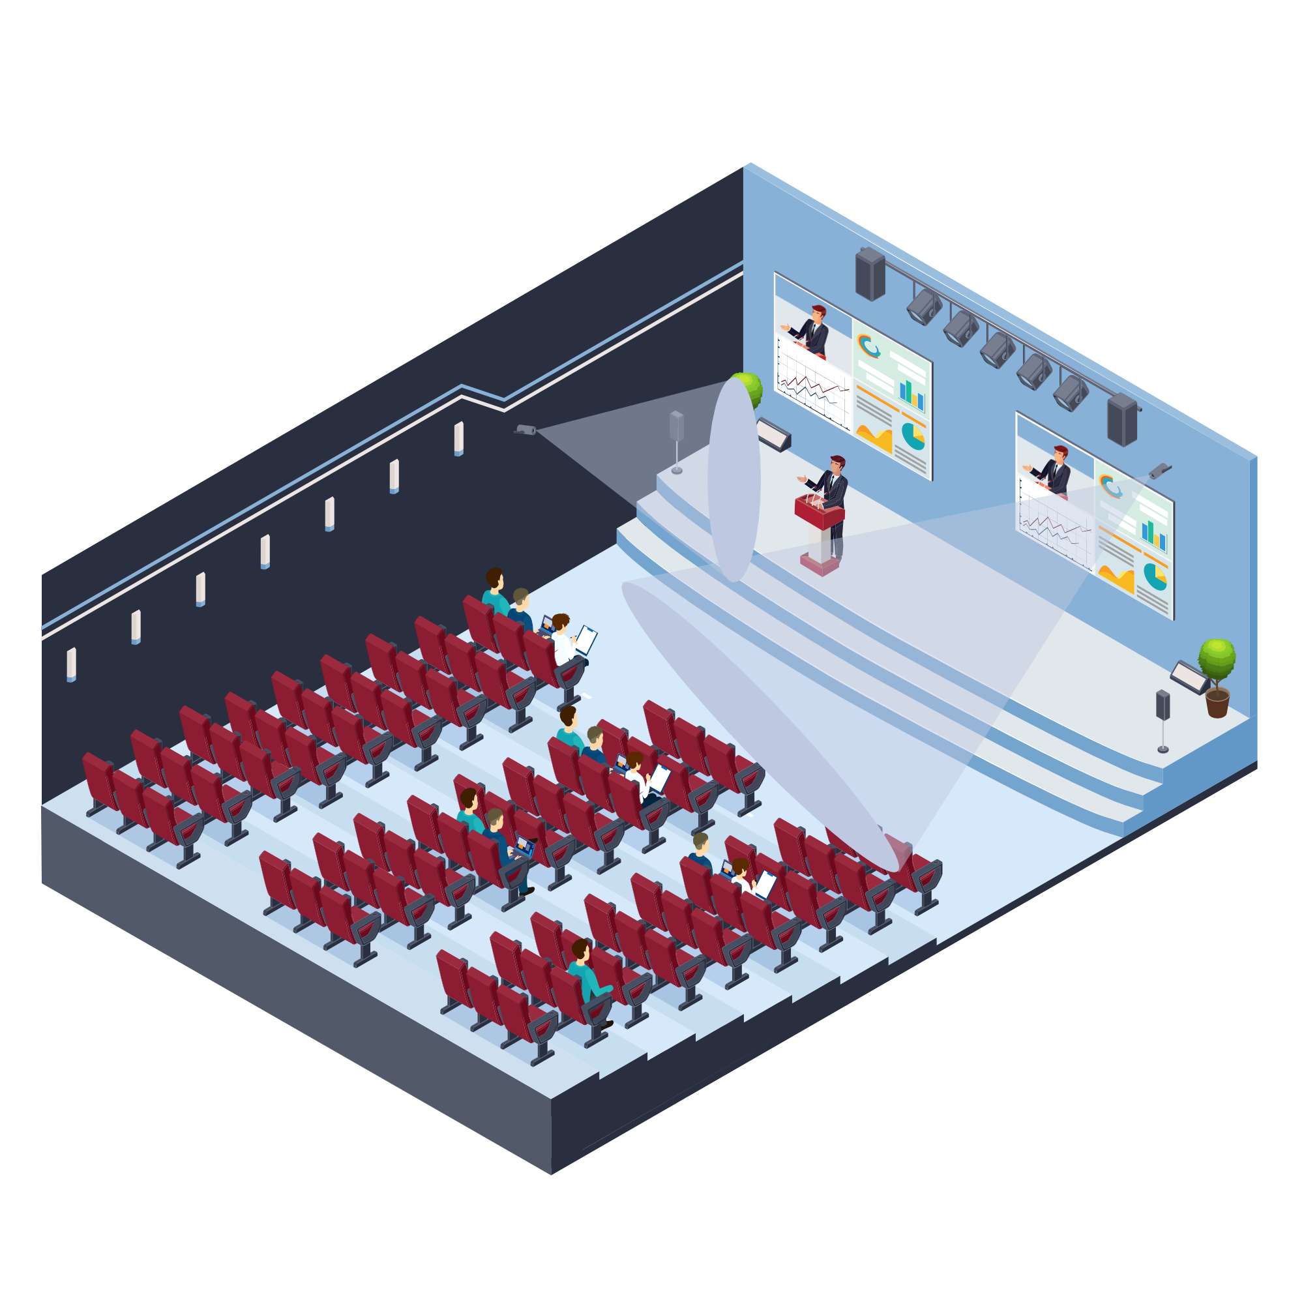
Vertical 3 (Enterprise Events)
The Solution: CAM-0402-NDI-BRG
Combines multiple event and production sources into one unified platform:
NDI cameras (stage, audience, wide shots)
HDMI sources (presentation content, media playback)
USB cameras (close-up or specialty angles)
Delivers a synchronized output across:
USB → Streaming platforms (OBS, vMix, Teams, Zoom)
HDMI → Confidence monitor or in-room display
Enables single-view or multiview production without complex switching systems or dedicated operators
Result: Professional, multi-camera live production made simple, scalable, and cost-effective
Powerful · Reliable · Simple

Slide 15
Key Benefits
Simplifies Multi-Camera Workflows
Combines NDI, HDMI, and USB sources into one system
Bridges AV and Conferencing
Converts professional AV workflows into a plug-and-play USB webcam
Enhances User Experience
Supports multi-angle or multiview output
Simple control via:
Buttons
Web UI
Control system / API
Teams app
Powerful · Reliable · Simple

Slide 16
Y.S.K
Use Case Positioning
Best suited for:
Conferencing
Education
Light production
Not intended to replace:
Full production switchers
Broadcast-grade systems
Multiview Limitations
Supports up to quad-view (4 sources on screen)
Not designed for:
Large production layouts (6–8+ windows)
Advanced broadcast-style scene compositions
Powerful · Reliable · Simple

Slide 17
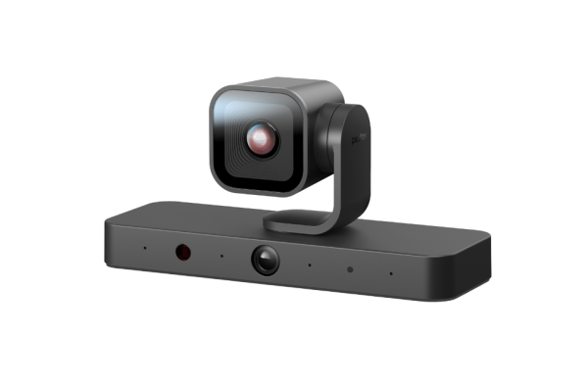
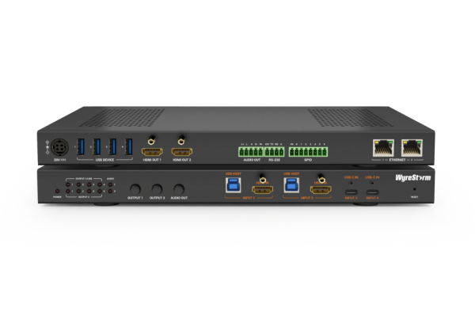
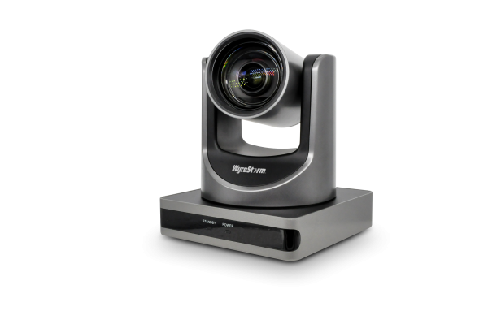
Products to include
MX-0402-H2-MST
4×2 Multi-Input Conference Room Switcher with Advanced USB-C Integration
CAM-420-PTZ
4K dual-lens AI PTZ Camera with NDI, HDMI, USB + AI Features
CAM-210-NDI-PTZ
1080p60 PTZ Camera with USB 3.0, HDMI Out, Auto Framing & Presenter Tracking + NDI
Powerful · Reliable · Simple

Slide 18
Questions?
Powerful · Reliable · Simple

